Slide 1
Examining What Drives B2B Buyers to Make a Tech Purchase
Buyers looking for tech solutions want vendors who make it easy to understand their options and decide with confidence.
Notes:
competition

Slide 3
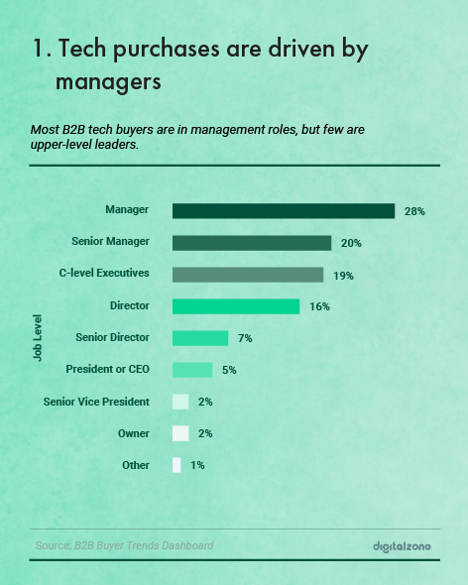

Slide 4
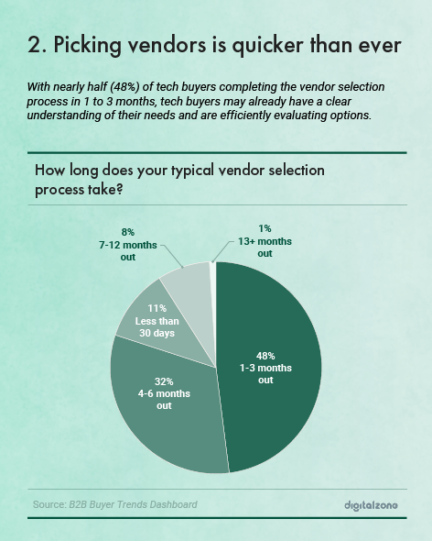

Slide 5
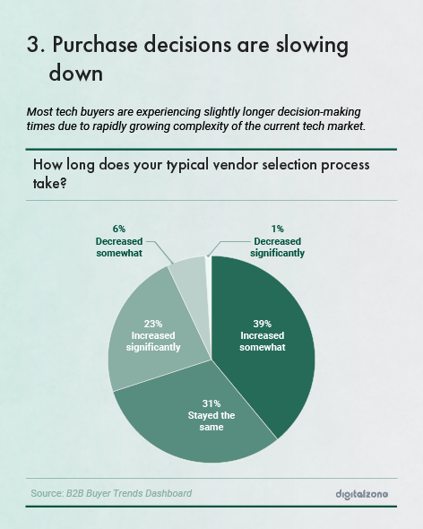

Slide 6
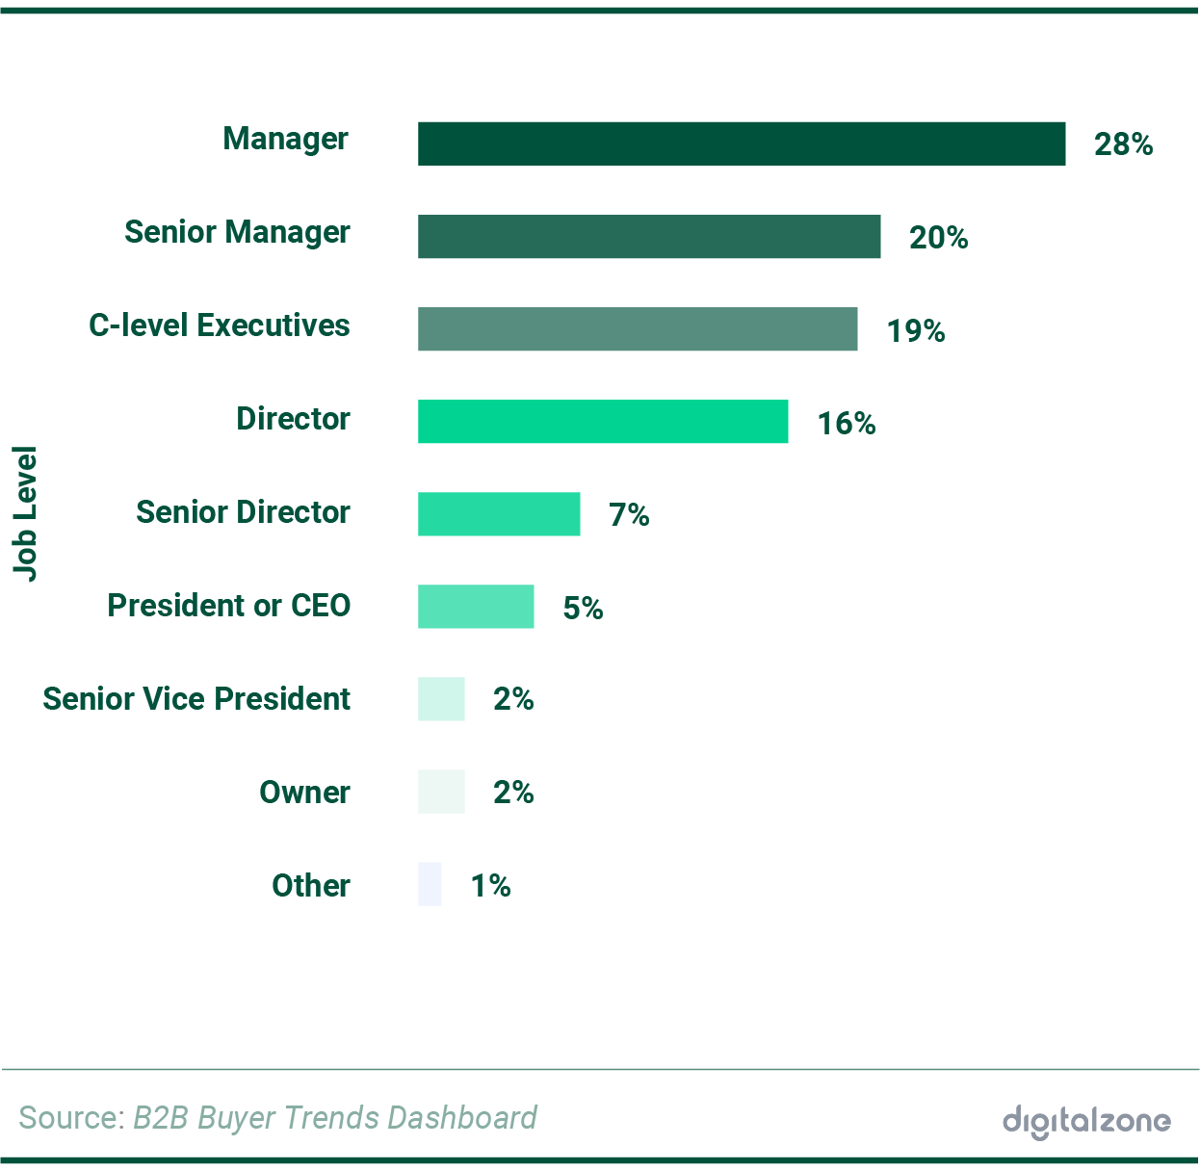

Slide 7
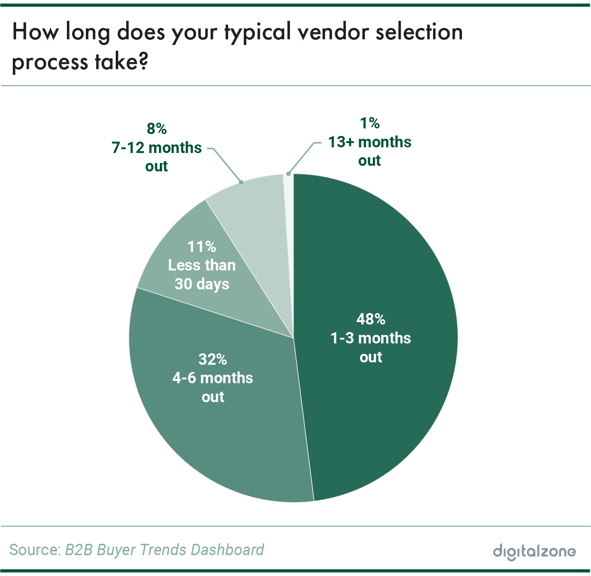

Slide 8
